Slide 1
VTOL AirCraft
Modern control
Dr. Sharifi
Roozbeh Bazargani
Kian Behzad
Mohammad Amini
Amir Bayat

Slide 2
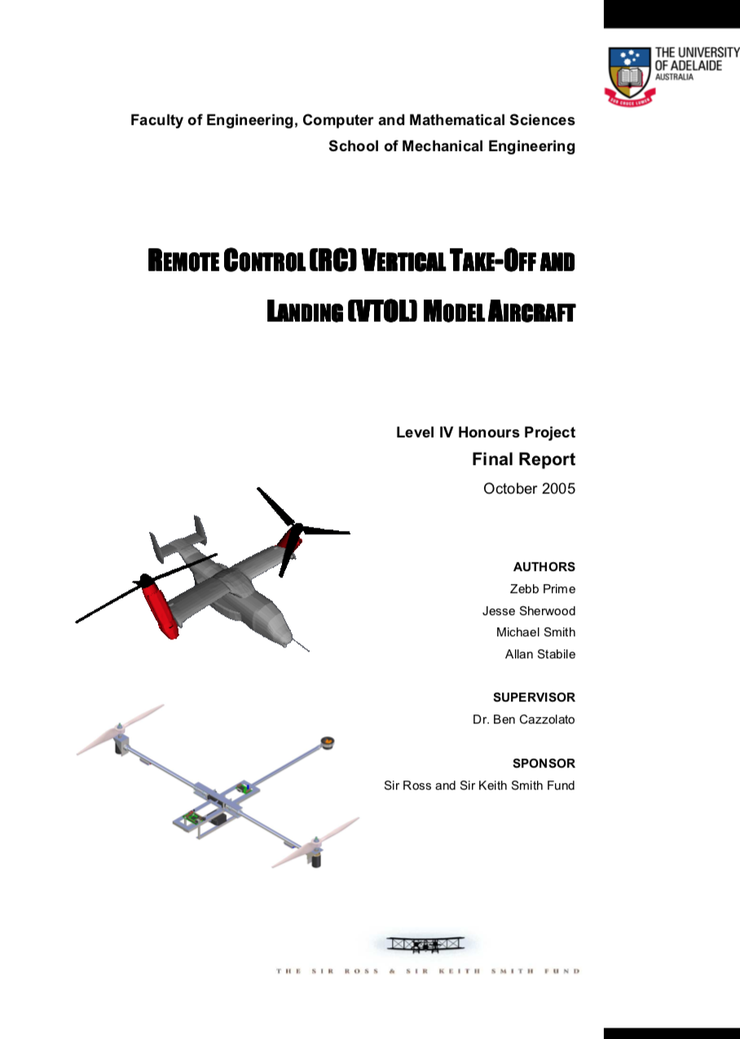
Paper for our project
2

Slide 3
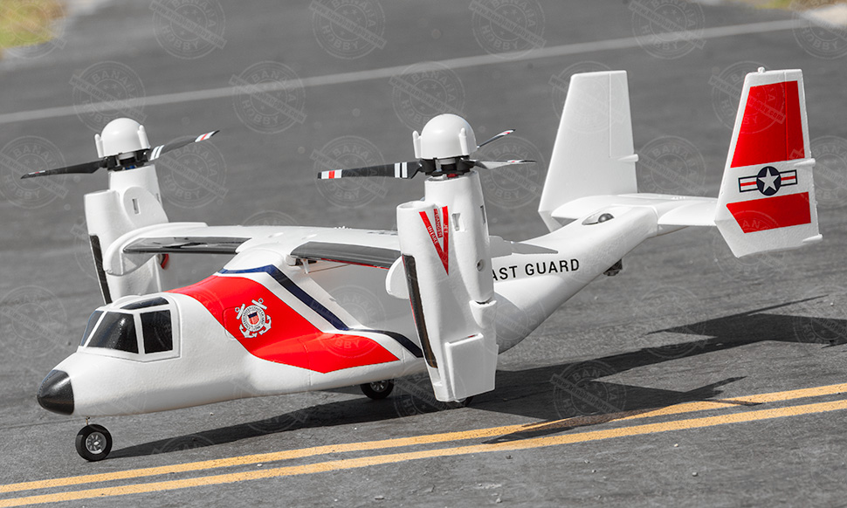
What is VTOL?

Slide 4
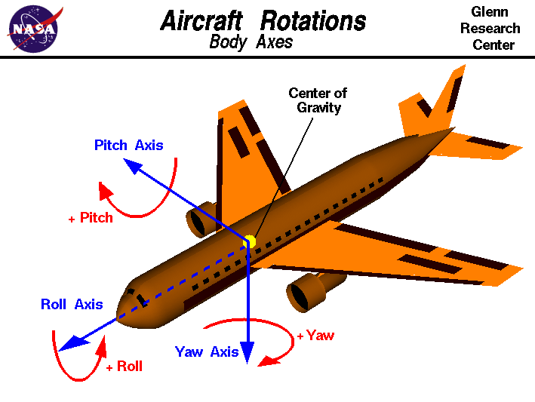

Slide 5
A - 1
Operation
Sensors
actuators

Slide 6
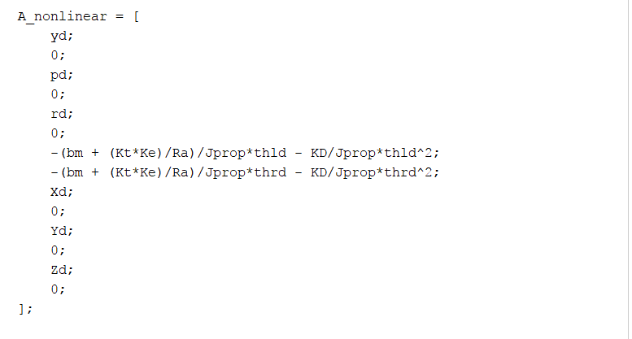
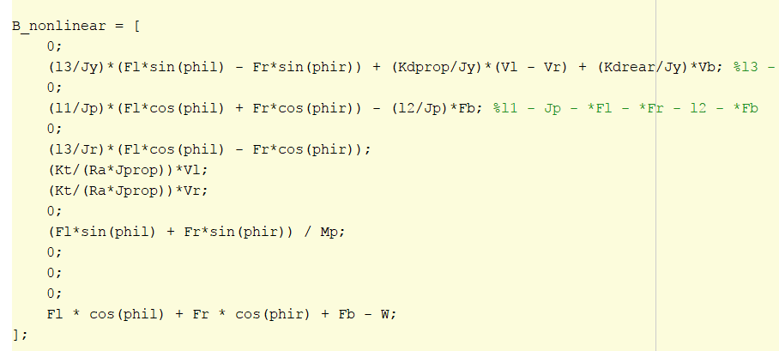
A - 2
Non-linear system
Parameters
Operation range

Slide 7
A - 3
Control goal

Slide 8
A - 4
Operation Point
op = [ 0, 0, 0, 0, 0, 0, 22.833, 22.833, 0, 0, 0, 0, 0, 0, 7.5217, 7.5217, 153.73, 0, 0]
[y, yd, p, pd, r, rd, thld, thrd, X, Xd, Y, Yd, Z, Zd, Vl , Vr, Vb, phil, phir]

Slide 9
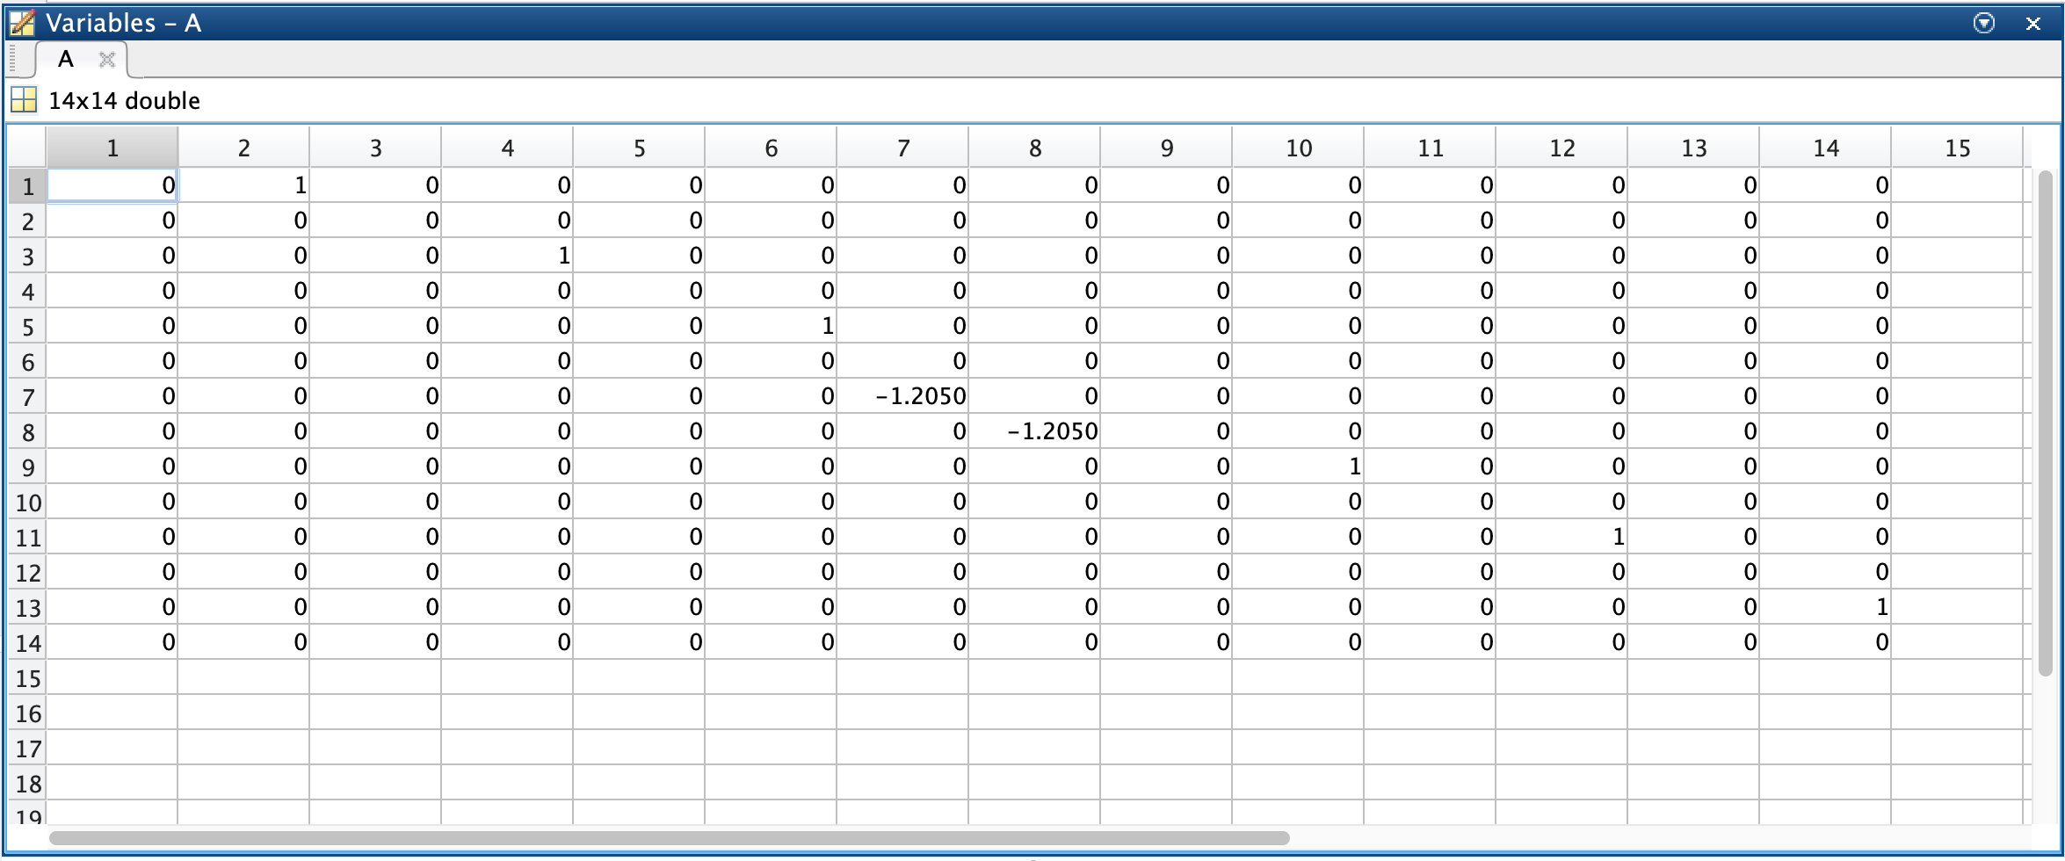
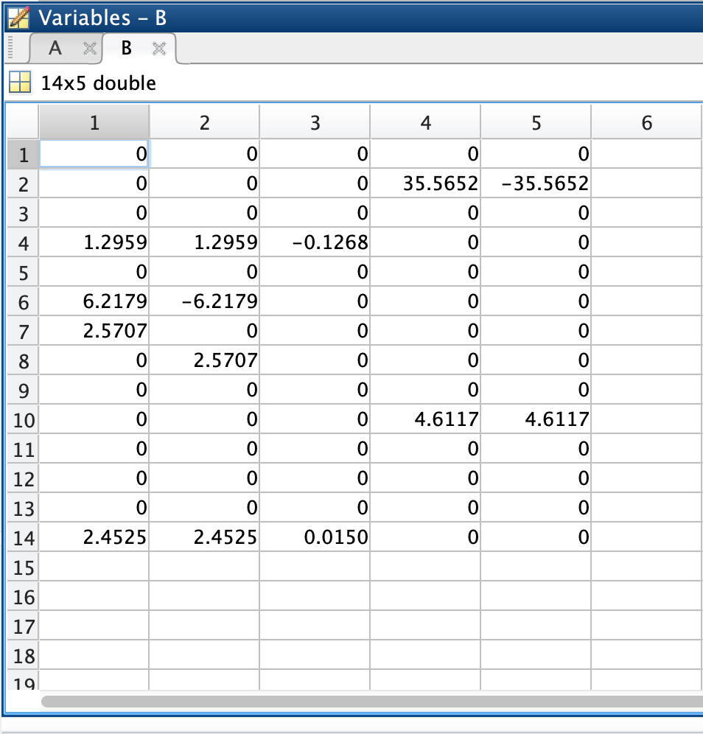
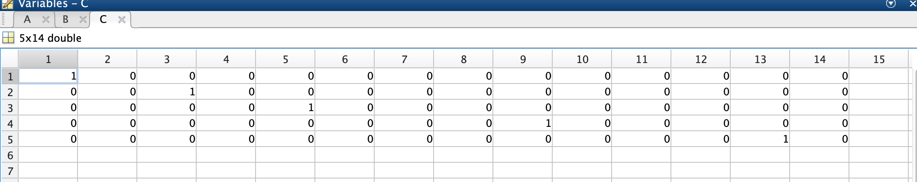
A - 4
Linearization

Slide 10
A - 5
Already a Jordan!

Slide 11
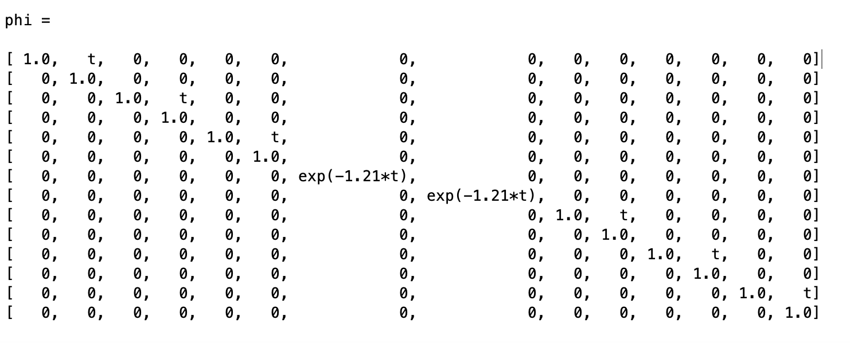
A - 6
State transformation matrix

Slide 12
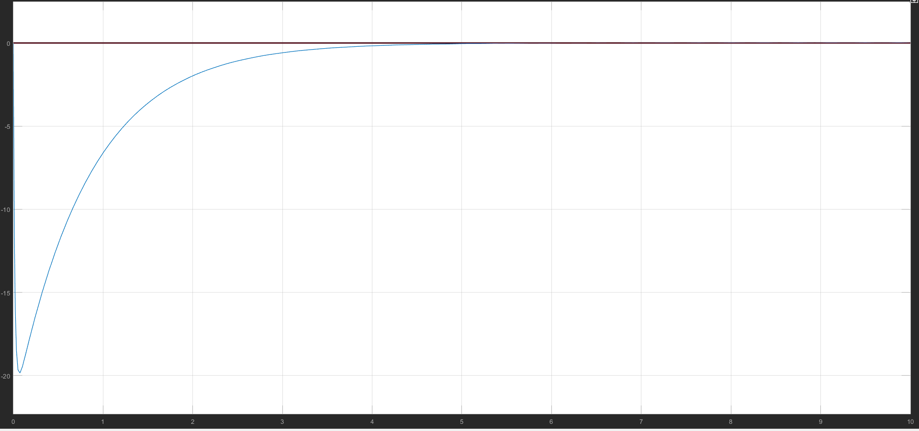
A - 6
Initial state response

Slide 13
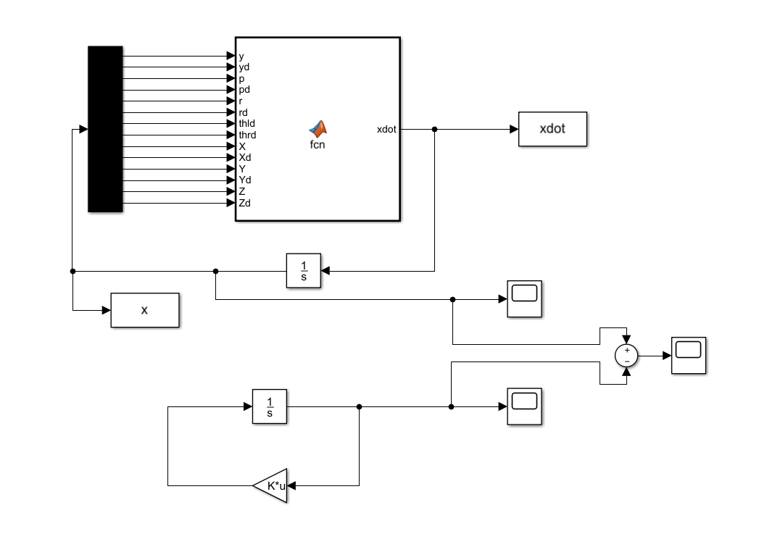
A - 6
Valid linear range

Slide 14
A - 8
Controllability : rank = 12
Observability : rank = 10

Slide 15
A - 9
UnControllable : Y – Ydot
UnObservable : thetaL dot – thetaR dot - Y- Ydot

Slide 16
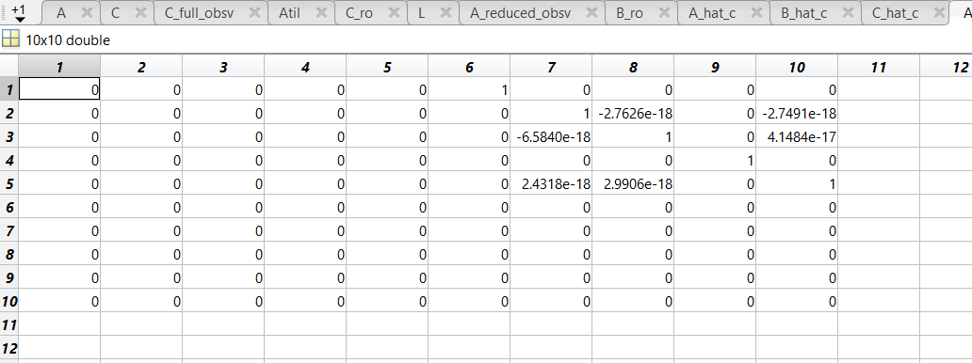
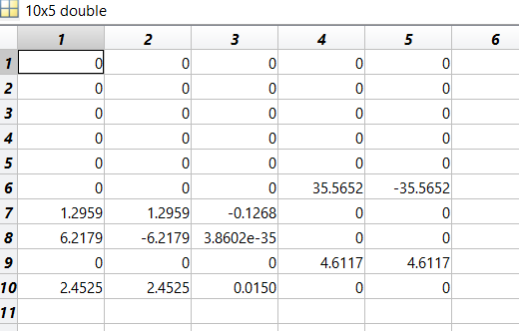
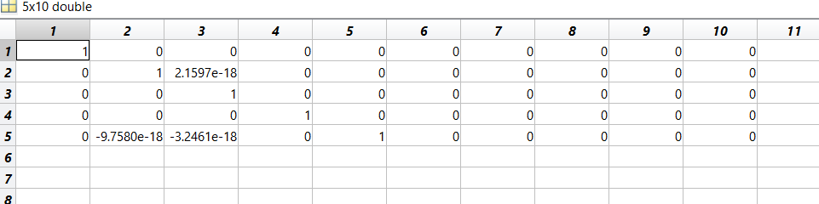
A - 10
Kalman - CO

Slide 17
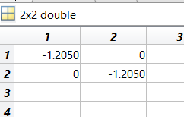
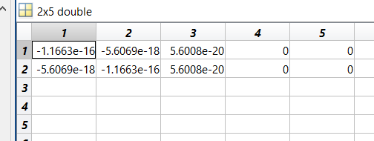
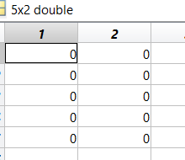
A - 10
Kalman - CbarO

Slide 18
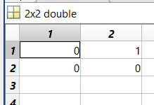
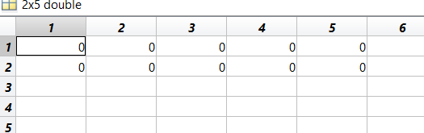
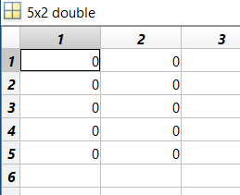
A - 10
Kalman - CbarObar

Slide 19
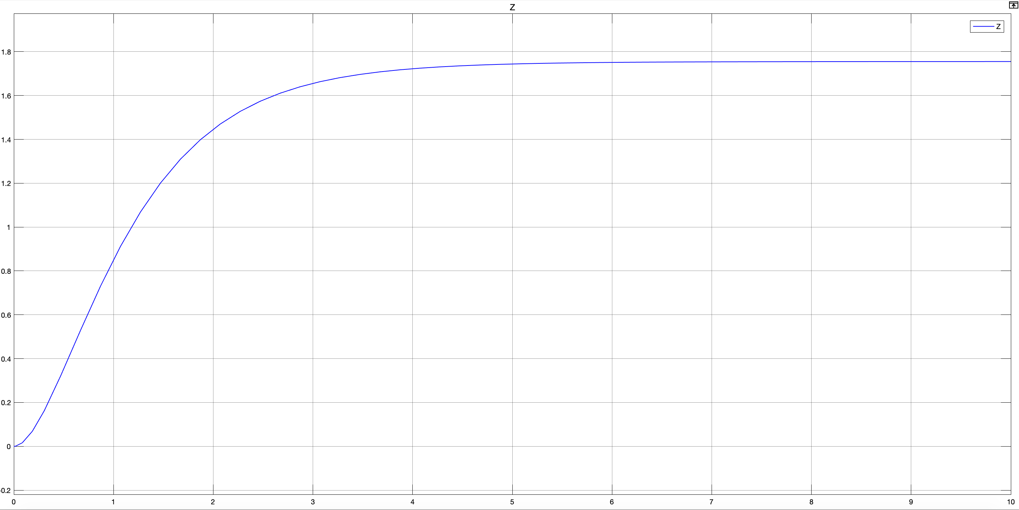
B - 1
State feedback

Slide 20
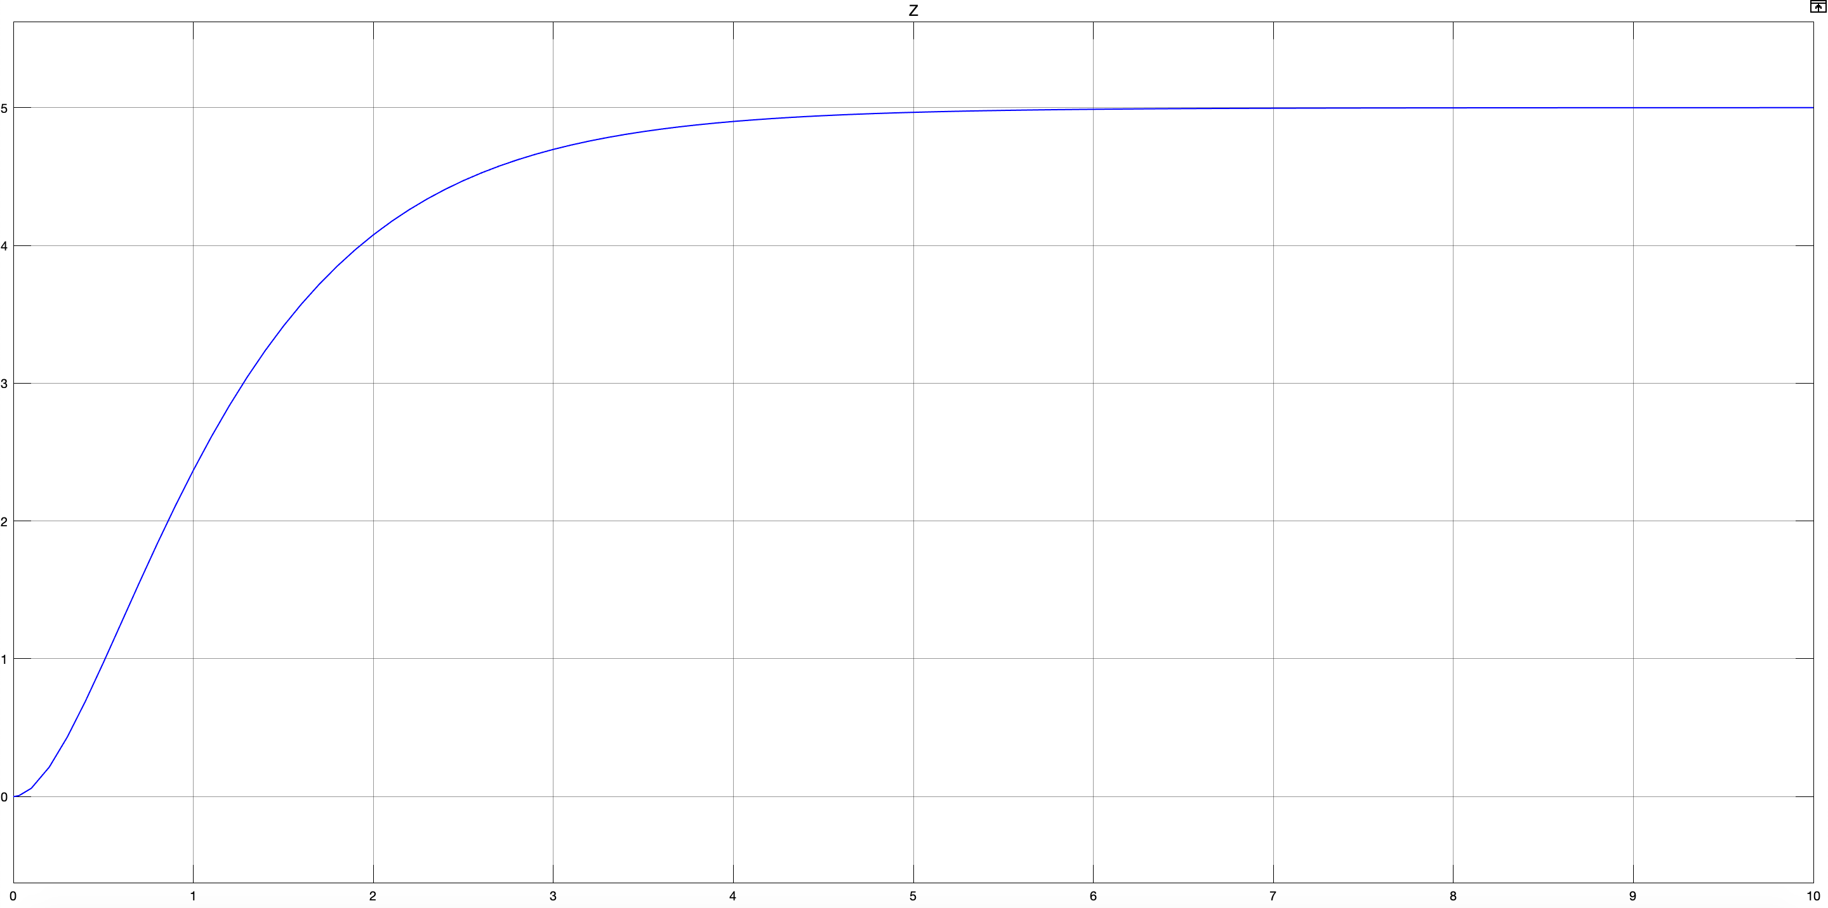
B - 2
State feedback + static prefilter

Slide 21
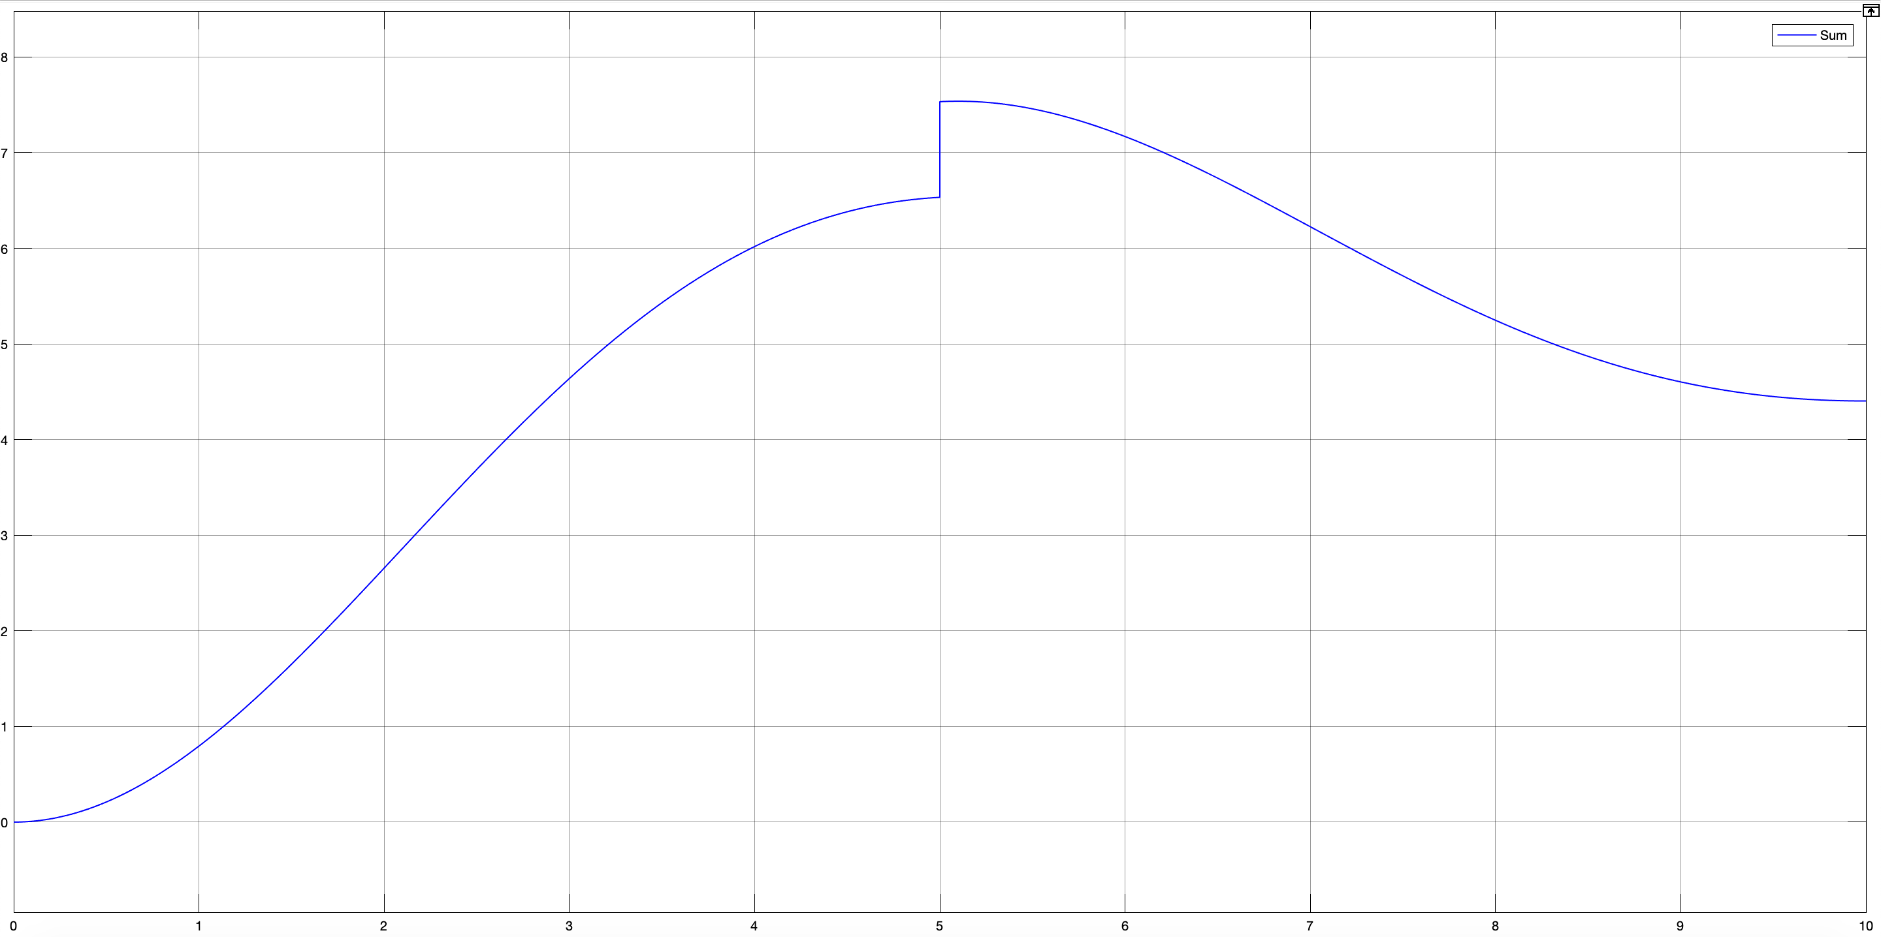
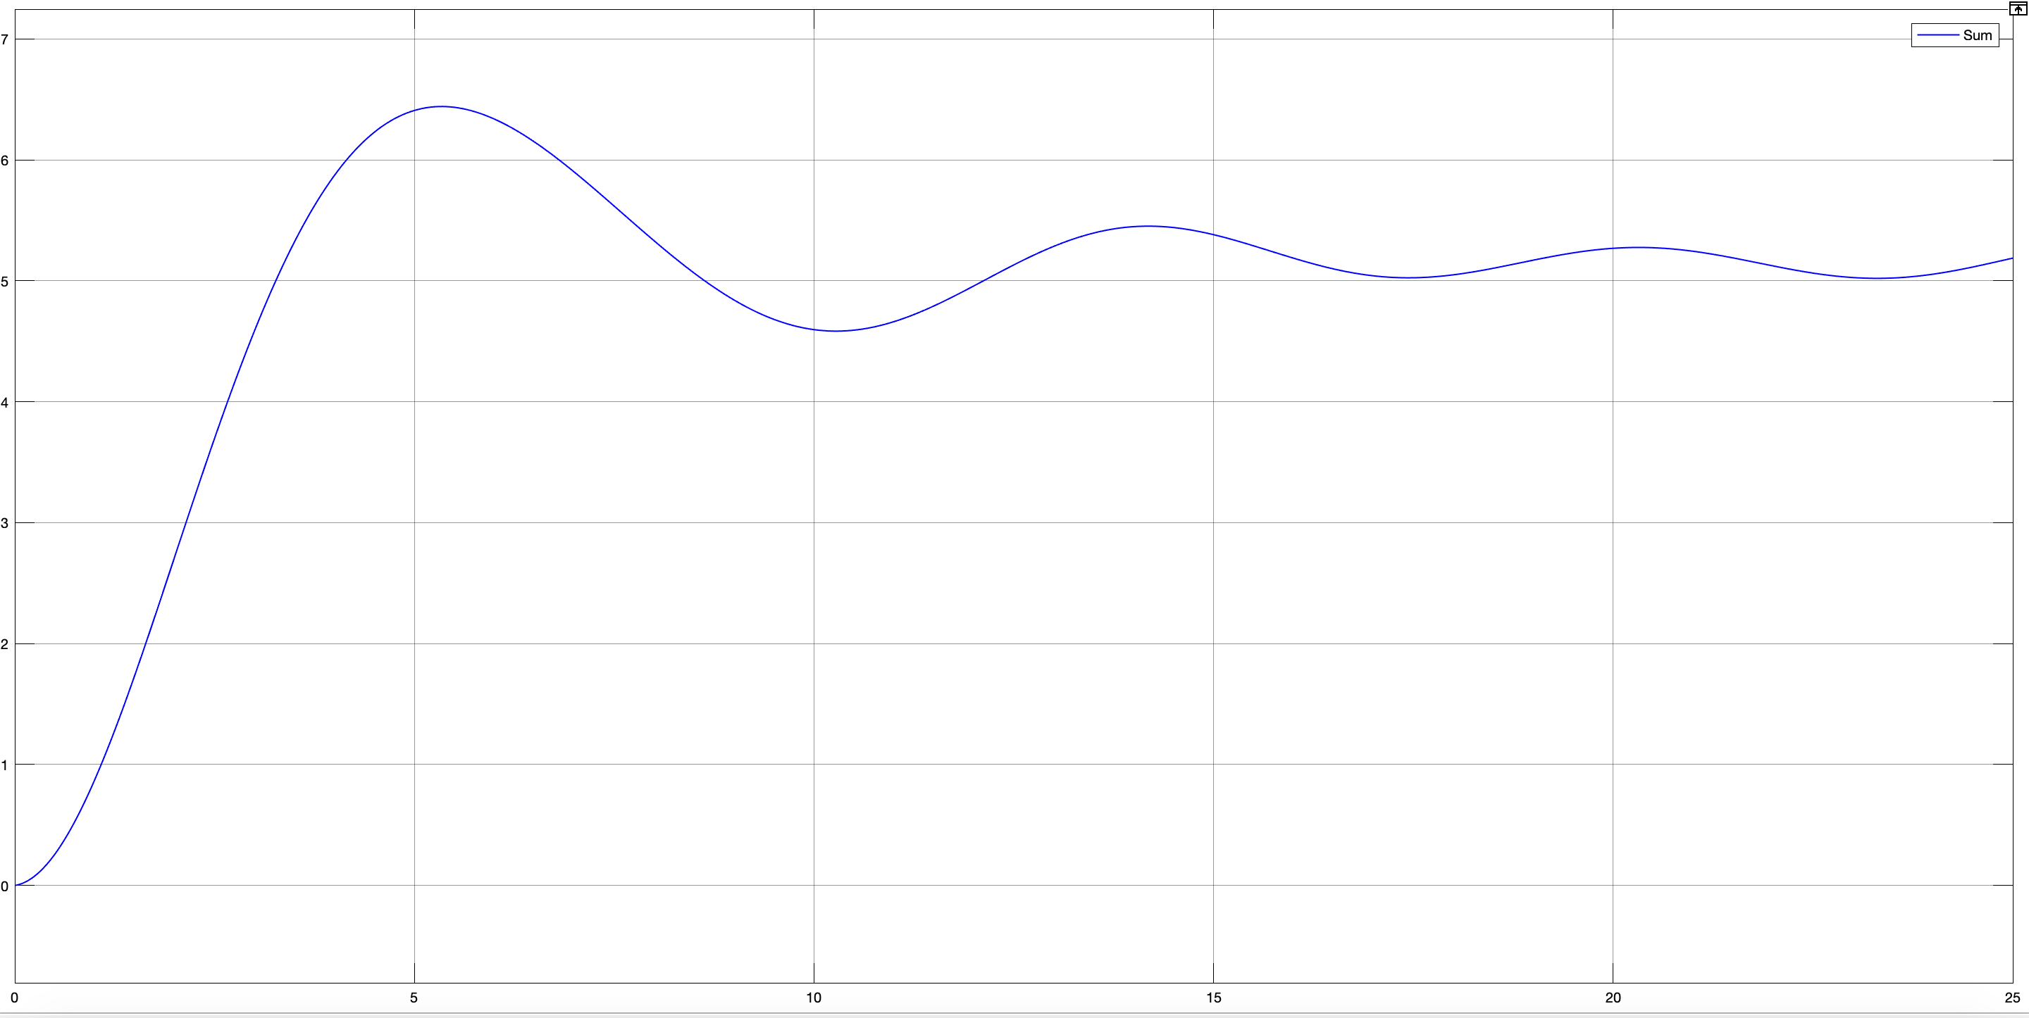
B - 3
State feedback + integral prefilter

Slide 22
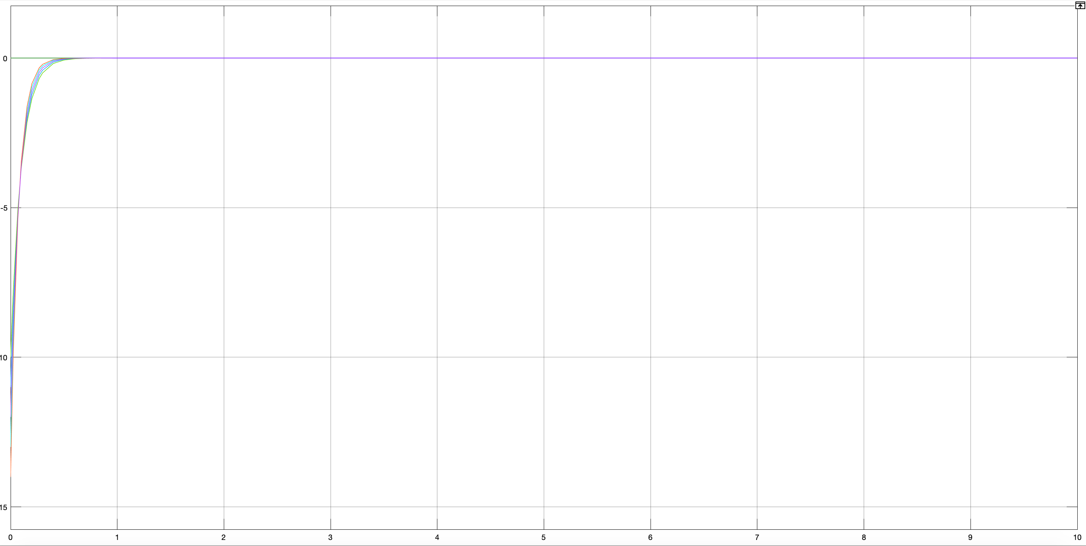
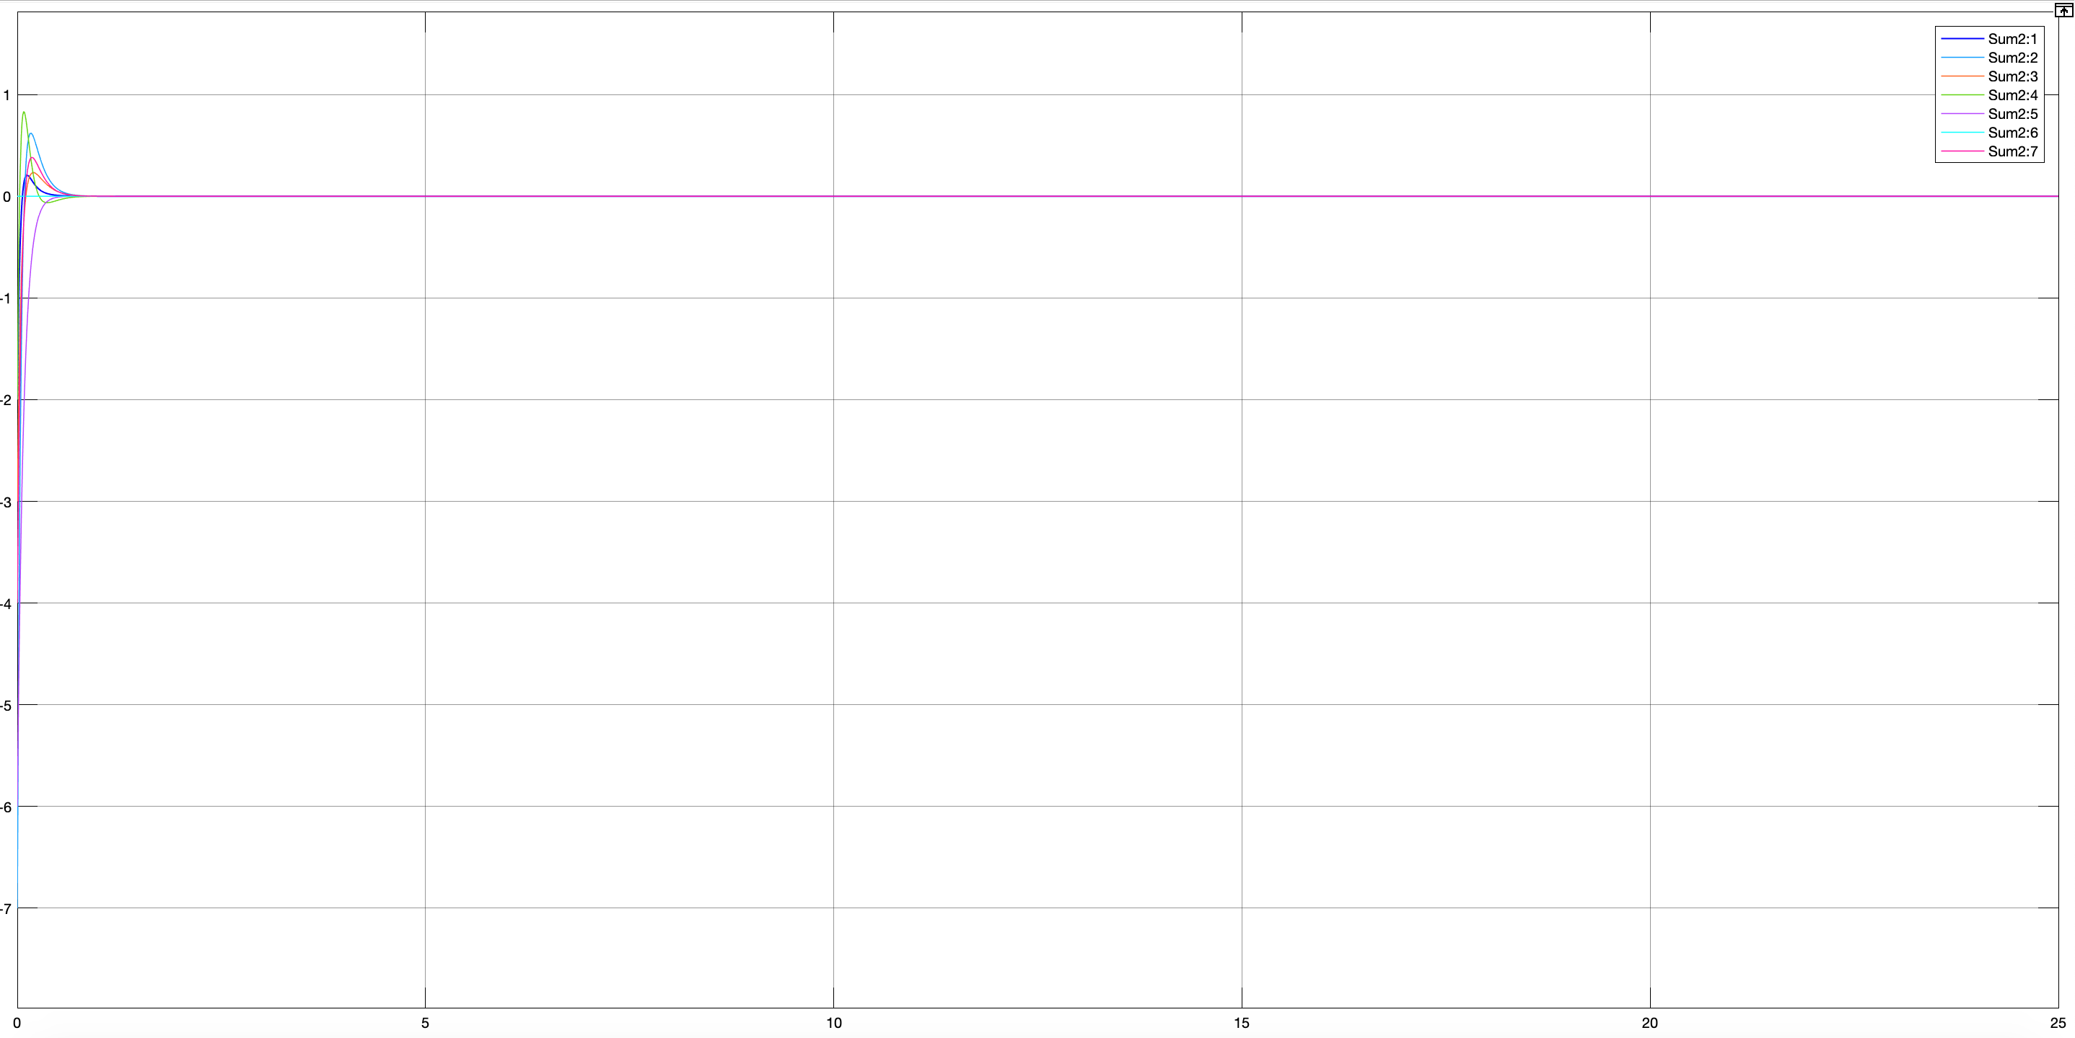
B - 4
Full and reduced observer

Slide 23
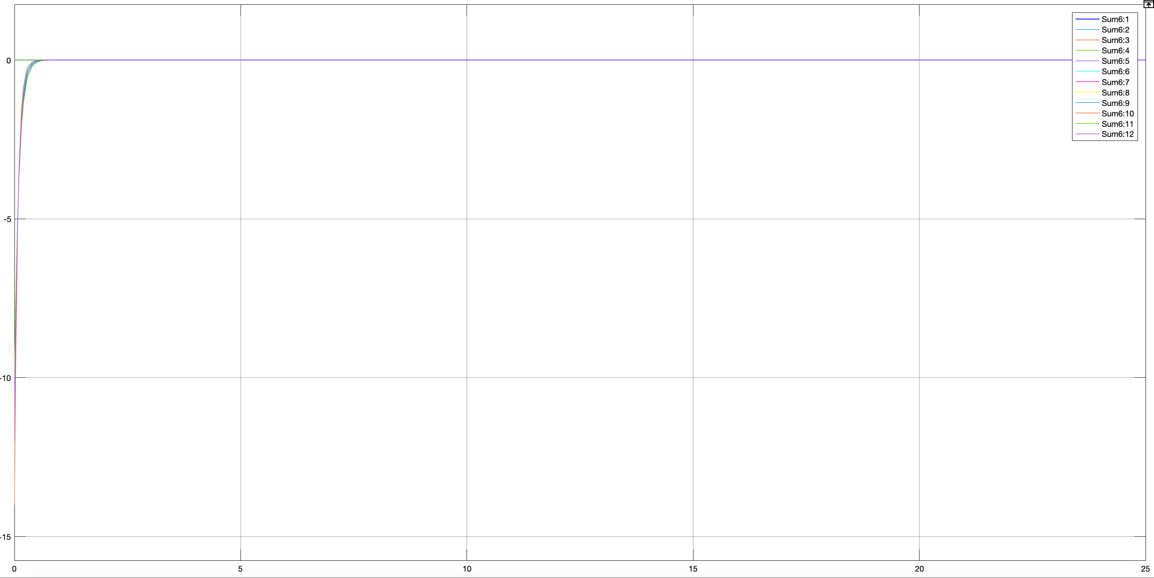
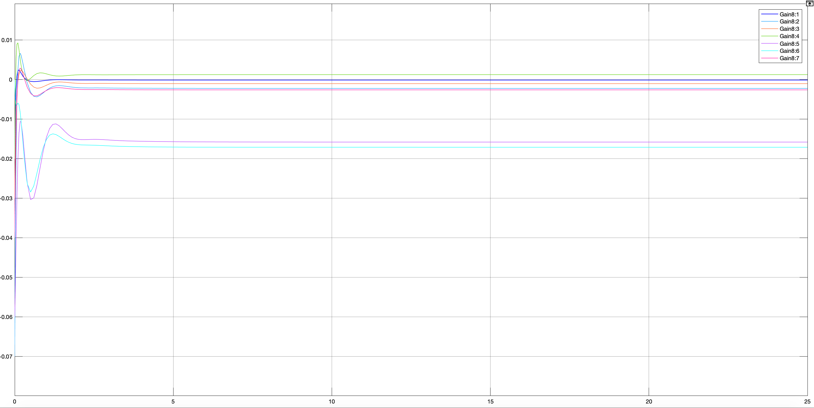
B - 5
State feedback using observer

Slide 24
C - 1
Equilibrium points
All 0!

Slide 25
C - 2
Stability
First method : not stable!
Second method : not stable too!
Not BIBO
Not asymptotically stable

Slide 26
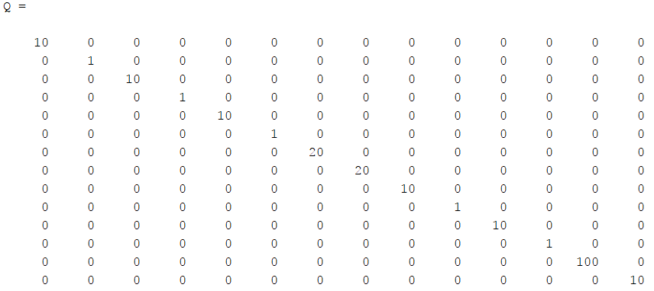
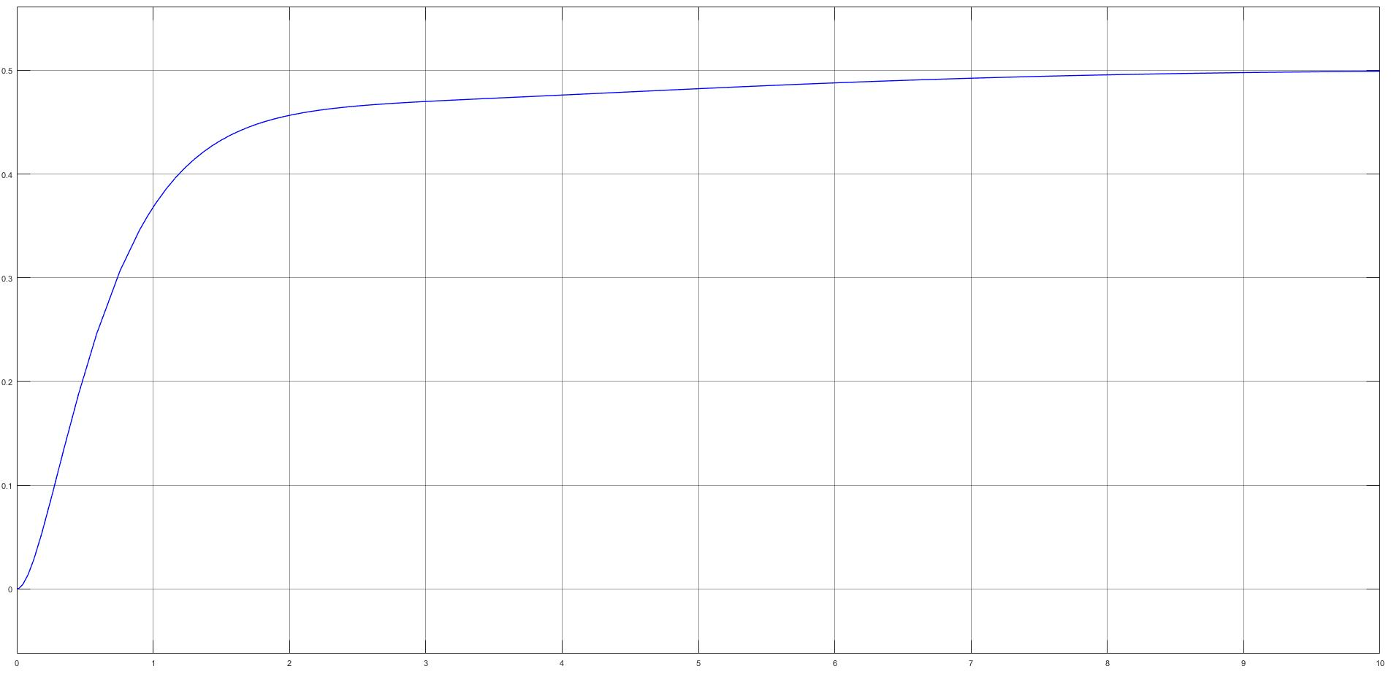
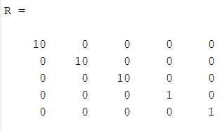
C - 3
Optimized control

Slide 27
References
https://www.mdpi.com/2226-4310/6/3/26/pdf
27/28

Slide 28
Thank You
28/28

